Slide 1
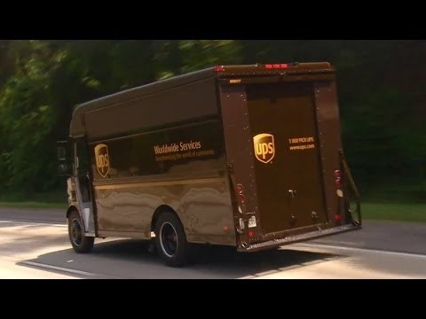
Algorithmic Complexity I CSE 120 Spring 2017
Instructor: Teaching Assistants:
Justin Hsia Anupam Gupta, Braydon Hall, Eugene Oh, Savanna Yee
Why UPS drivers don’t turn left and you probably shouldn’t either
UPS solves versions of the vehicle routing problem. In these mathematical problems, you are given a set of points and the distances between them, and you have to find the best route(s) to travel through all of them.
UPS have designed their vehicle routing software to eliminate as many left-hand turns as possible. Typically, only 10% of the turns are left turns. As a result, the company claims it uses 10m gallons less fuel, emits 20,000 tonnes less carbon dioxide and delivers 350,000 more packages every year.
https://theconversation.com/why-ups-drivers- dont-turn-left-and-you-probably-shouldnt-either- 71432

Slide 2
Administrivia
Assignments:
Binary Practice (4/21)
Creativity Assignment (4/24)
Midterm in class on Wednesday, 4/26
1 sheet of notes (2-sided, letter, handwritten)
Fill-in-the-blank(s), short answer questions, maybe simple drawing
Questions will cover lectures, assignments, and readings
Midterm Review sheet will be released tonight (4/19), will be covered in lab next week (4/25)

Slide 3
Outline
Algorithm Analysis: The Basics
Comparing Algorithms
Orders of Growth

Slide 4
Algorithm Correctness
An algorithm is considered correct if for every input, it reports the correct output and doesn’t run forever or cause an error
Incorrect algorithms may run forever, crash, or not return the correct answer
But they could still be useful!
e.g. an approximation algorithm
Showing correctness
Mathematical proofs for algorithms
Empirical verification of implementations
Notes:
Mathematical formal methods are needed to prove the GENERAL correctness of algorithm, like does it solve the problem, like does it actually finish.
Empirical methods are used to test a concrete implementation of an algorithm on concrete data

Slide 5
Algorithm Analysis
One commonly used criterion for analyzing algorithms is computation time
How long does the algorithm take to run and finish its task?
Can be used to compare different algorithms for the same computational problem
How to measure this time?
Counting in my head
Stopwatch
Within your program

Slide 6
Aside: Computation Time
Computers take time to complete their tasks
Under the hood, it’s sort of like a bunch of buckets of water filling up – you have to wait for water to reach the top of a bucket for a single computation to complete
Buckets take about a billionth of a second to fill (~ 1 nanosecond)
There are billions of them on a single chip!
A CPU can generally only execute one instruction at a time

Slide 7
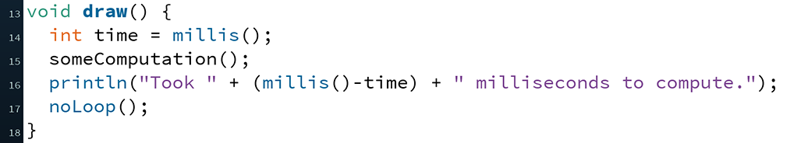
Timing in Processing
The function millis() returns the number of milliseconds since starting your program (as an int)
To start timing, call and store the value in a variable
Call again after your computation and subtract the values

Slide 8
Outline
Algorithm Analysis: The Basics
Comparing Algorithms
Orders of Growth

Slide 9
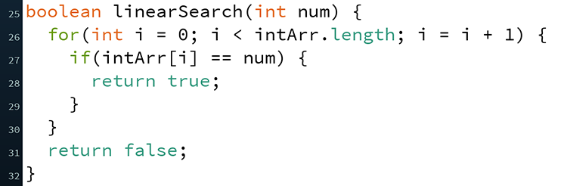
Algorithm: Searching A Sorted Array
Input: Numbers in a sorted array, desired number
Output: If desired number is in the array (true/false)
Algorithm 1:
Check each index starting from 0 for desired number
If equal, then report true
If not equal, then move to next index
If at end of array, then report false
Called Linear Search (also works for unsorted array)

Slide 10
Algorithm: Searching A Sorted Array
Input: Numbers in a sorted array, desired number
Output: If desired number is in the array (true/false)
Algorithm 2:
Check “middle” index for desired number
If equal, then report true
If less than desired number, check halfway forwards next
If greater than desired number, check halfway backwards next
If no halfway point left, then report false
Called Binary Search
http://www.cs.armstrong.edu/liang/animation/web/BinarySearch.html

Slide 11
Peer Instruction Question
On average, which algorithm would take less time to complete a search?
Vote at http://PollEv.com/justinh
Algorithm 1 (Linear Search)
Algorithm 2 (Binary Search)
They’d take about the same amount of time

Slide 12
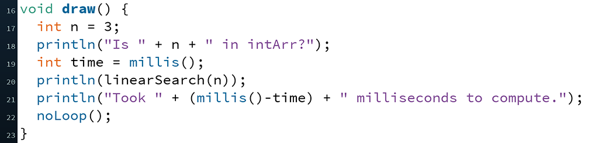
Measuring Linear Search
Let’s time Linear Search:
One issue: our algorithm seems to be too fast to measure!
How can we fix this?

Slide 13
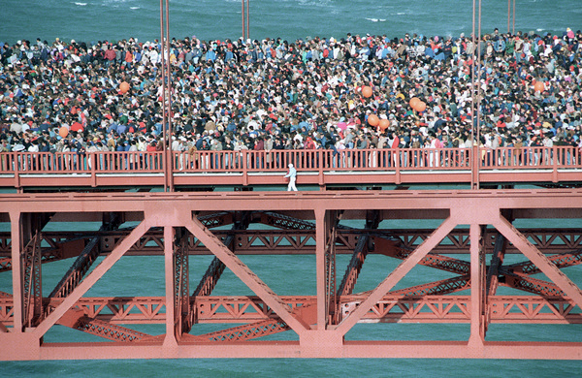
Best Case vs. Worst Case vs. Average Case
We were measuring close to the best case!
Didn’t matter how long our array was
Could measure average case instead
Run many times on random numbers and average results
Instead, we’ll do worst case analysis. Why?
Nice to know the most time we’d ever spend
Worst case happens often
Average case is often similar to worst case
Notes:
Golden Gate Bridge bent by people celebrating its 50th anniversary party.
http://www.nytimes.com/1987/05/26/us/golden-gate-crowd-made-bridge-bend.html

Slide 14
Example of Worst Case in Action
Many web servers out there run something called “The Apache HTTP Server” (or just Apache for short)
When a user enters a particular URL, Apache delivers the correct files from the server to the person on the internet
An old version of Apache had a bug where if you entered a URL with tons of consecutive slashes, it could take hours to complete the request
e.g. http://someurl.com/////////////////////
Bottom line: an algorithm is often judged by its worst case behavior

Slide 15
What is the Worst Case?
Discuss with your neighbor (no voting):
Assume intArr.length is 1000000 and intArr[i] = i;
What is a worst case argument for num for Linear Search?
What is a worst case argument for num for Binary Search?
1
500000
1000000
1000001
Something else

Slide 16
Timing Experiments
Let’s try running Linear Search on a worst case argument value
Results: 54, 31, 53, 34
Now let’s run Binary Search on a worst case argument value
Results: 0, 0, 0, 0

Slide 17
Runtime Intuition
Does it seem reasonable that the runtimes were inconsistent?
Some reasons:
Your computer isn’t just running Processing – there’s a lot of other stuff running (e.g. operating system, web browser)
The computer hardware does lots of fancy stuff to avoid slowdown due to physical limitations
These may not work as well each execution based on other stuff going on in your computer at the time

Slide 18
Empirical Analysis Conclusion
We’ve shown that Binary Search is seemingly much faster than Linear Search
Similar to having two sprinters race each other
Limitations:
Different computers may have different runtimes
Same computer may have different runtime on same input
Need to implement the algorithm in order to run it
Goal: come up with a “universal algorithmic classifier”
Analogous to coming up with a metric to compare all athletes (or fighters)

Slide 19
Outline
Algorithm Analysis: The Basics
Comparing Algorithms
Orders of Growth

Slide 20
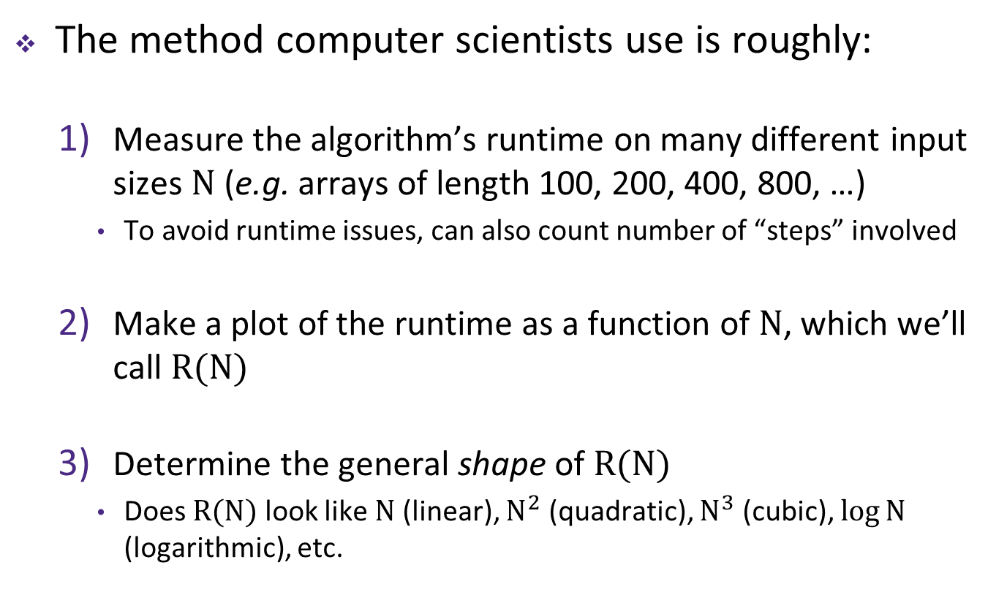
Characterizing Algorithms
The method computer scientists use is roughly:
Measure the algorithm’s runtime on many different input sizes $N$ (e.g. arrays of length 100, 200, 400, 800, …)
To avoid runtime issues, can also count number of “steps” involved
Make a plot of the runtime as a function of $N$, which we’ll call $R(N)$
Determine the general shape of $R(N)$
Does $R(N)$ look like $N$ (linear), $N^{2}$ (quadratic), $N^{3}$ (cubic), $\log{N}$ (logarithmic), etc.

Slide 21
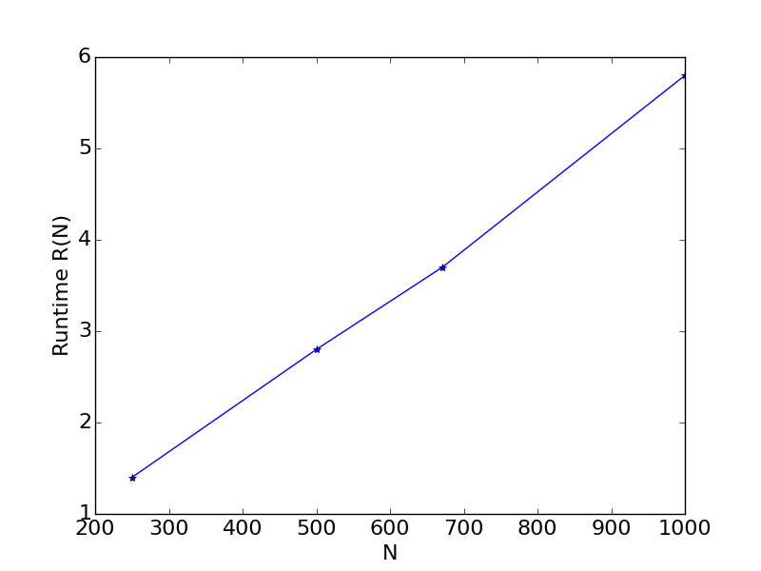
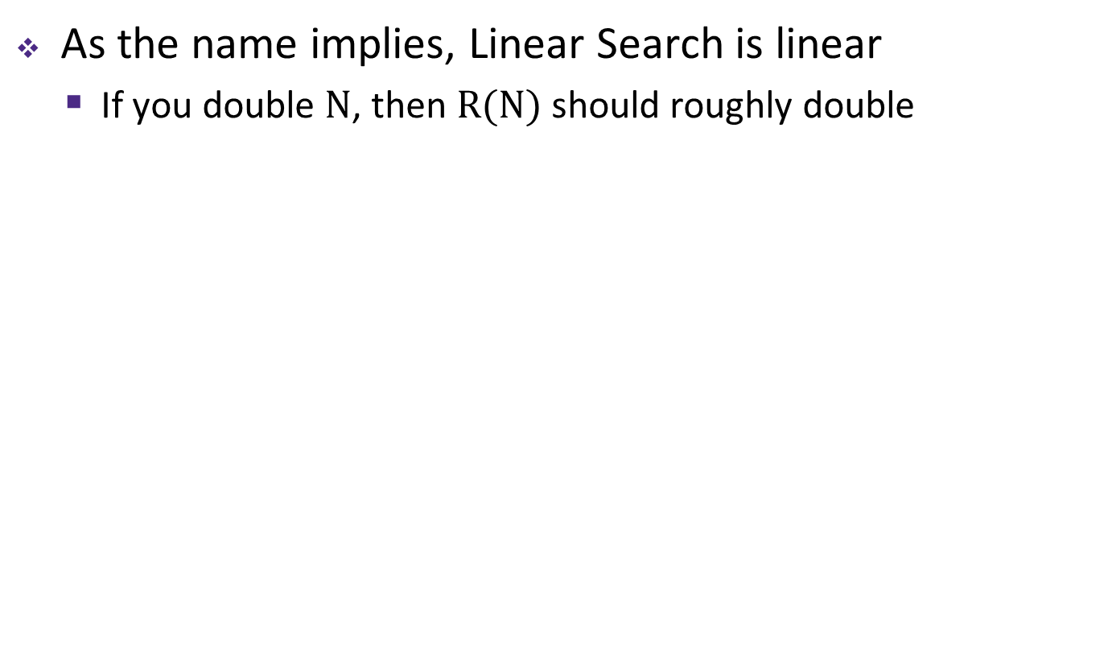
Linear Search
As the name implies, Linear Search is linear
If you double $N$, then $R(N)$ should roughly double
$N$ (input size) | $R(N)$ (time)
250 items | 1.4 sec
500 items | 2.8 sec
671 items | 3.8 sec
1000 items | 5.7 sec

Slide 22
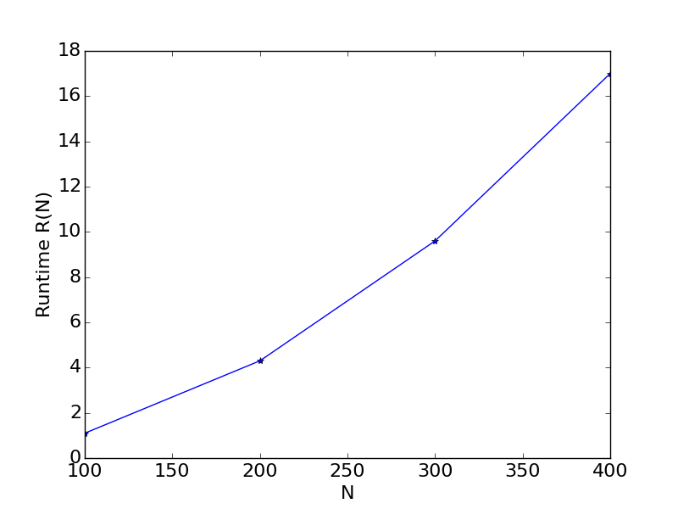
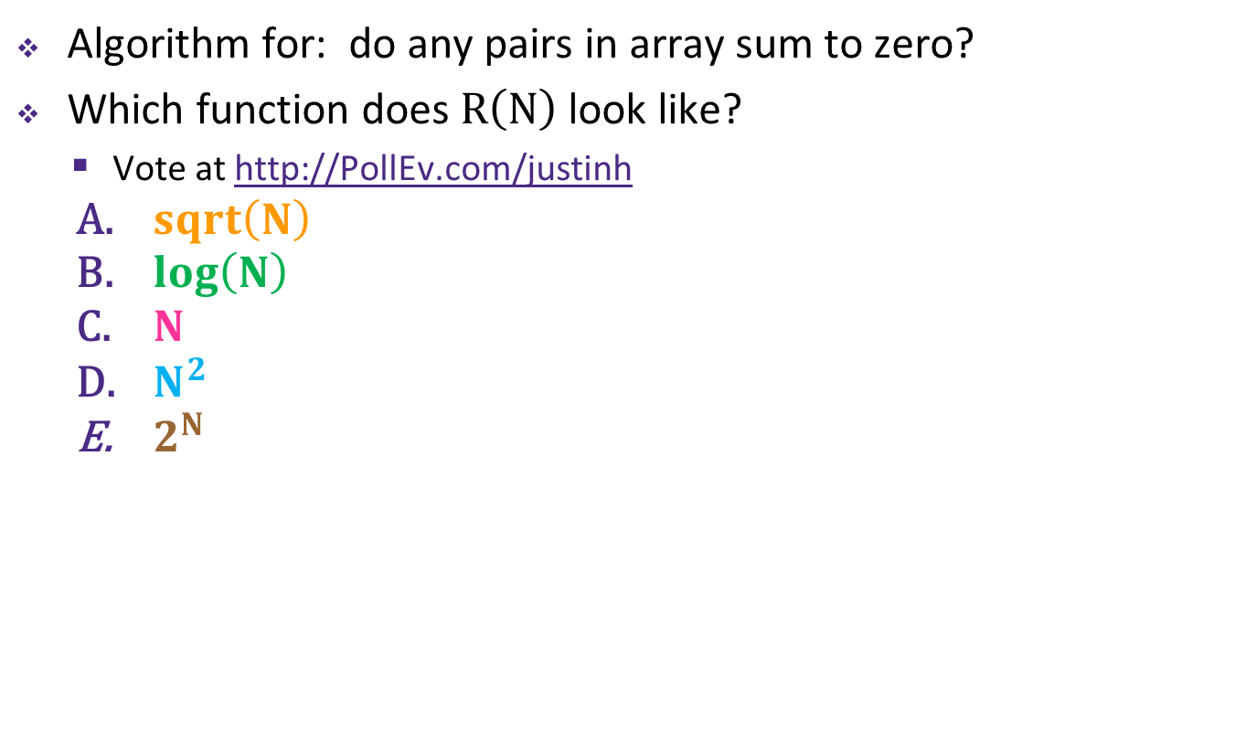
Peer Instruction Question
Algorithm for: do any pairs in array sum to zero?
Which function does $R\left(N\right)$ look like?
Vote at http://PollEv.com/justinh
$sqrt\left(N\right)$
$log\left(N\right)$
$N$
$N^{2}$
$2^{N}$
$N$ (input size) | $R(N)$ (time)
100 items | 1.1 seconds
200 items | 4.3 seconds
300 items | 9.6 seconds
400 items | 17.0 seconds

Slide 23
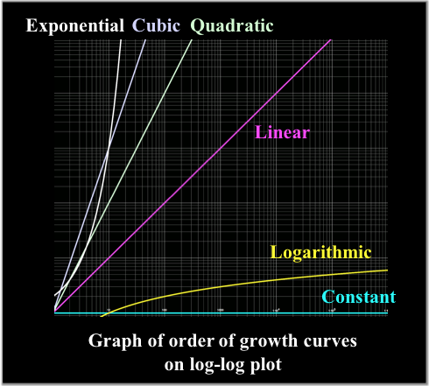
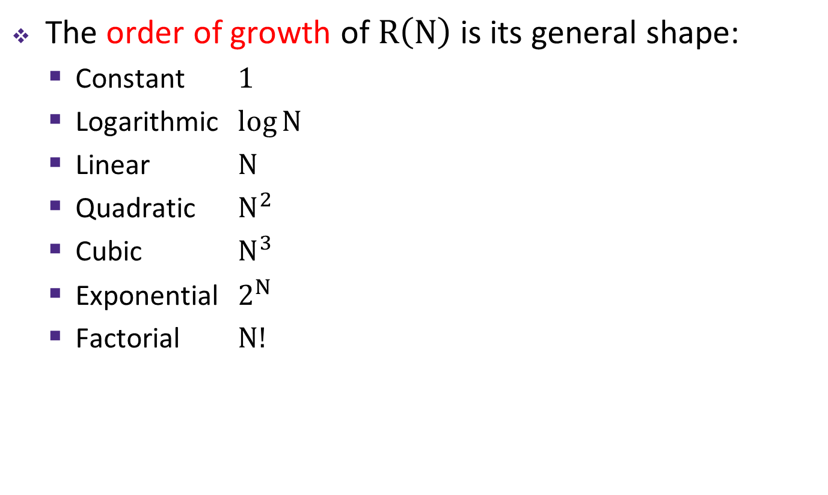
Orders of Growth
The order of growth of $R\left(N\right)$ is its general shape:
Constant $1$
Logarithmic $\log{N}$
Linear $N$
Quadratic $N^{2}$
Cubic $N^{3}$
Exponential $2^{N}$
Factorial $N!$

Slide 24
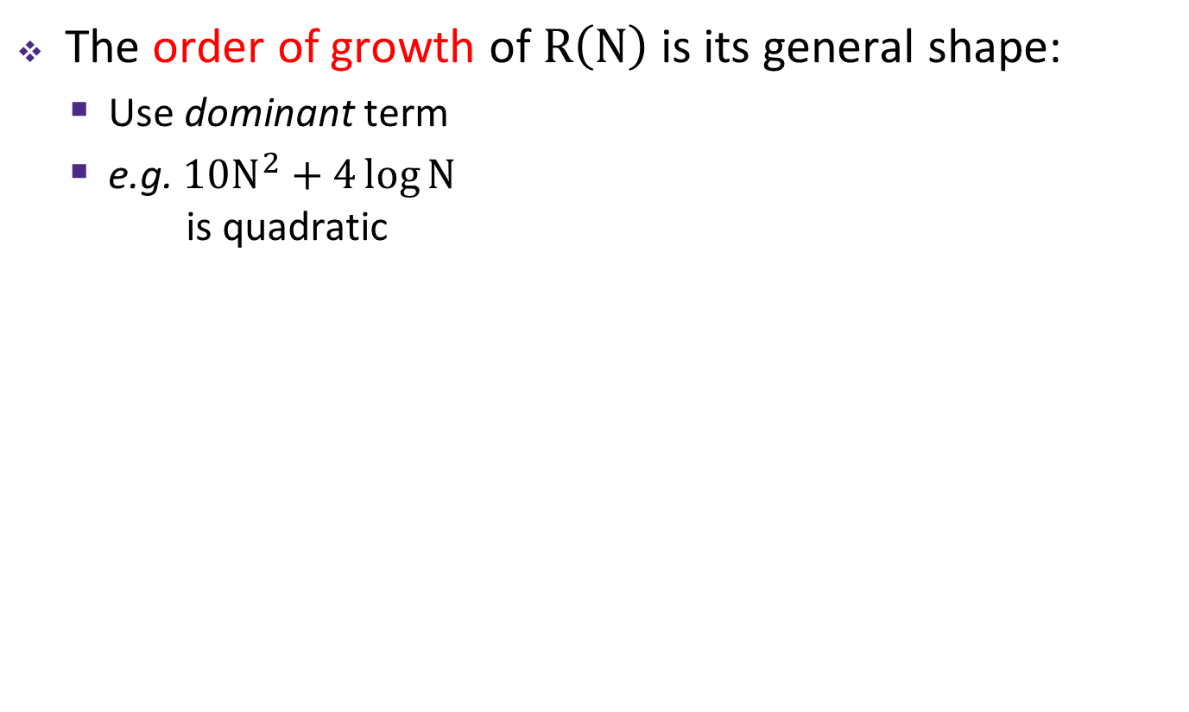
Orders of Growth
The order of growth of $R\left(N\right)$ is its general shape:
Use dominant term
e.g. $10N^{2}+4\log{N}$ is quadratic

Slide 25
Binary Search
What order of growth is Binary Search?
Analyze using number of “steps” in worst case
$N$ (input size) | Indices to Check
1 items
2 items
4 items
8 items
16 items

Slide 26
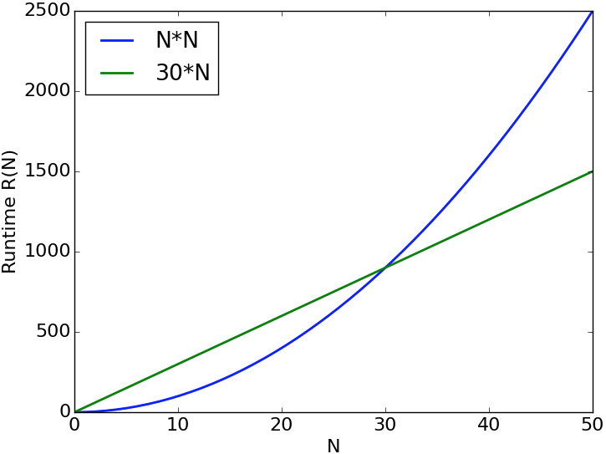
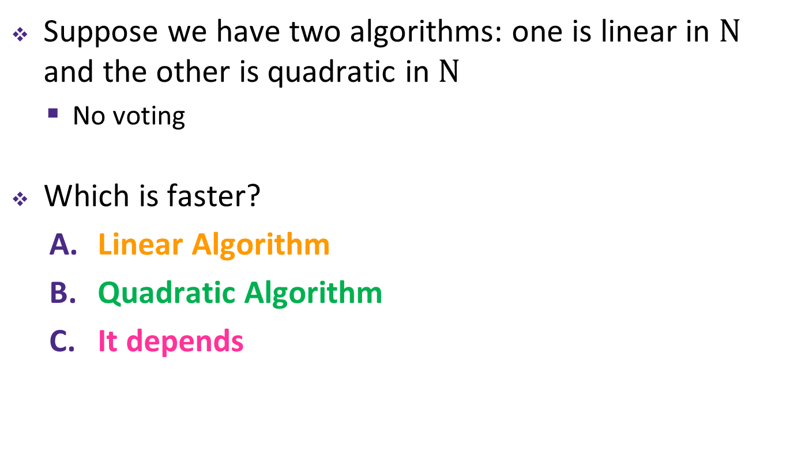
Which is Faster?
Suppose we have two algorithms: one is linear in $N$ and the other is quadratic in $N$
No voting
Which is faster?
Linear Algorithm
Quadratic Algorithm
It depends

Slide 27
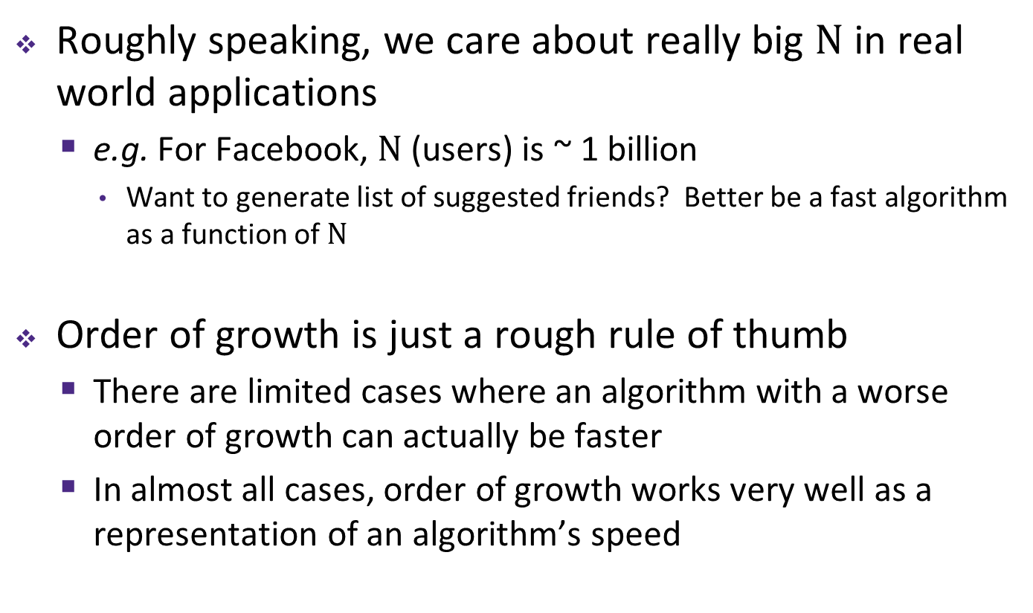
The Reason Order of Growth Matters
Roughly speaking, we care about really big $N$ in real world applications
e.g. For Facebook, $N$ (users) is ~ 1 billion
Want to generate list of suggested friends? Better be a fast algorithm as a function of $N$
Order of growth is just a rough rule of thumb
There are limited cases where an algorithm with a worse order of growth can actually be faster
In almost all cases, order of growth works very well as a representation of an algorithm’s speed

Slide 28
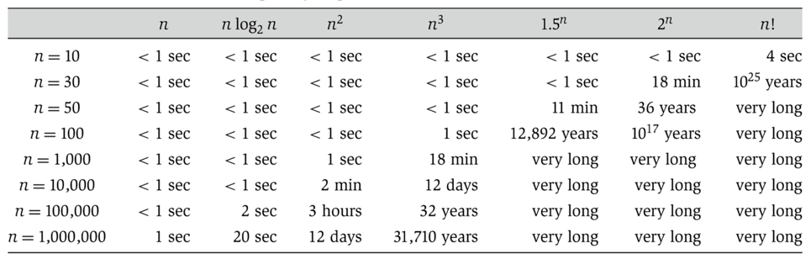
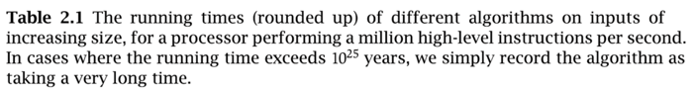
Orders of Growth Comparison
The numbers below are rough estimates for a “typical” algorithm on a “typical” computer – provides a qualitative difference between the orders of growth
Linearithmic
Linear
Quadratic
Cubic
Exponential
Exponential
Factorial

Slide 29
Artificial Intelligence CSE 120 Spring 2017
Slide credits: Pieter Abbeel, Dan Klein, Stuart Russell, Pat Virtue & http://csillustrated.berkeley.edu
Instructor: Teaching Assistants:
Justin Hsia Anupam Gupta, Braydon Hall, Eugene Oh, Savanna Yee
Candy Grab Game
Grab a pack of “game pieces” (at least 10 per pair of students)
Play the following game
10 pieces on the table
Take turns taking either 1 or 2 pieces
Player that takes the last piece(s) wins ☺
How do humans learn to play this game?
How would a computer learn to play this game?
int takeTurn(int numPiecesAvailable)

Slide 30
Administrivia
Assignments:
Tic-Tac-Toe due tonight (5/19)
Project Proposal due Saturday (5/20)
Innovation Exploration post due Sunday (5/21)
Project:
Dream big! It’s okay to scale back later
You might be surprised at what you can accomplish
Feel free to brainstorm with a staff member
Make it something that you’re excited about

Slide 31
Outline
What is AI?
AI History
AI winter and the resurgence
AI Today
Applications and how they work
AI Tomorrow
Ethics and the singularity

Slide 32
Artificial Intelligence
Why learn about AI?
Funding to private AI companies globally
(in millions of $)
2012 2013 2014 2015 2016
https://www.cbinsights.com/blog/artificial-intelligence-startup-funding/

Slide 33
Candy Grab Game
int takeTurn(int numPiecesAvailable) {
return ?;
}

Slide 34
Candy Grab Game
Agent 001 – always choose 1
int takeTurn(int numPiecesAvailable) {
return 1;
}

Slide 35
Candy Grab Game
Agent 002 – always choose 2
int takeTurn(int numPiecesAvailable) {
return 2;
}

Slide 36
Candy Grab Game
Agent 007 – whatever you think is best
int takeTurn(int numPiecesAvailable) {
return ?;
}

Slide 37
Candy Grab Game
Agent 007 – whatever you think is best
int takeTurn(int numPiecesAvailable) {
if(numPiecesAvailable%3 == 2) {
return 2;
} else {
return 1;
}
}

Slide 38
Candy Grab Game
Agent 007 – whatever you think is best
int takeTurn(int numPiecesAvailable) {
return ?;
}
What if we had:
boolean willIWin(int numPiecesAvailable, boolean isMyTurn, int action)

Slide 39

Candy Grab Game
Agent 007 – whatever you think is best
int takeTurn(int numPiecesAvailable) {
return ?;
}

Slide 40

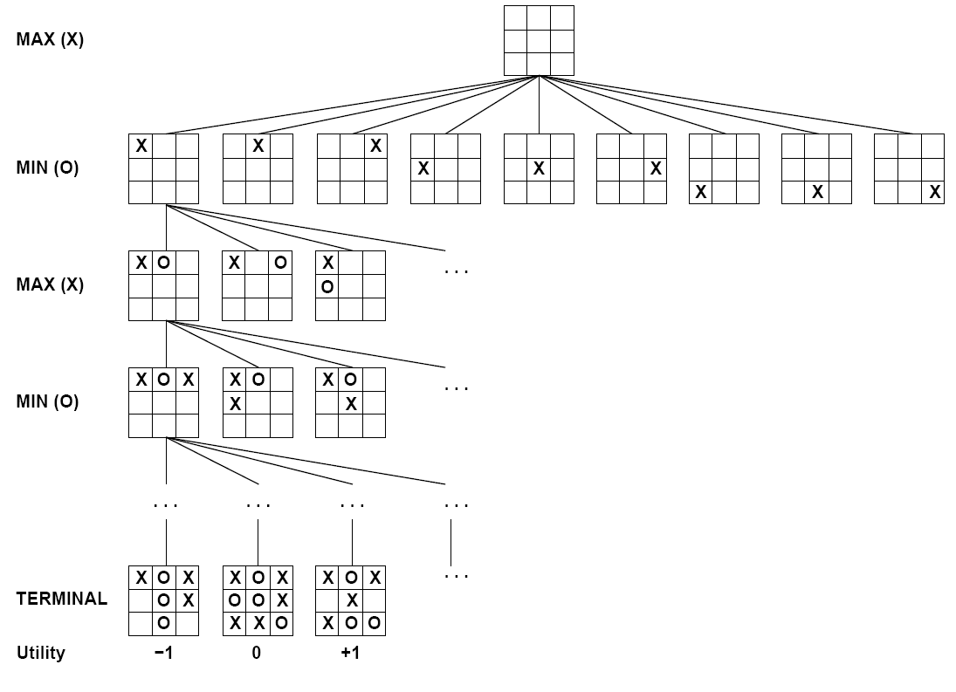

How: Search & Planning
I take an action… then what? … then what?

Slide 41
Candy Grab Game (Min-Max)
Agent 007 – whatever you think is best
int takeTurn(int numPiecesAvailable)

Slide 42
Candy Grab Game (Statistical)
Agent 007 – whatever you think is best
int takeTurn(int numPiecesAvailable)
Pieces Available | Take 1 | Take 2
2 | 0% | 100%
3 | 2% | 1%
4 | 75% | 2%
5 | 4% | 68%
6 | 5% | 6%

Slide 43
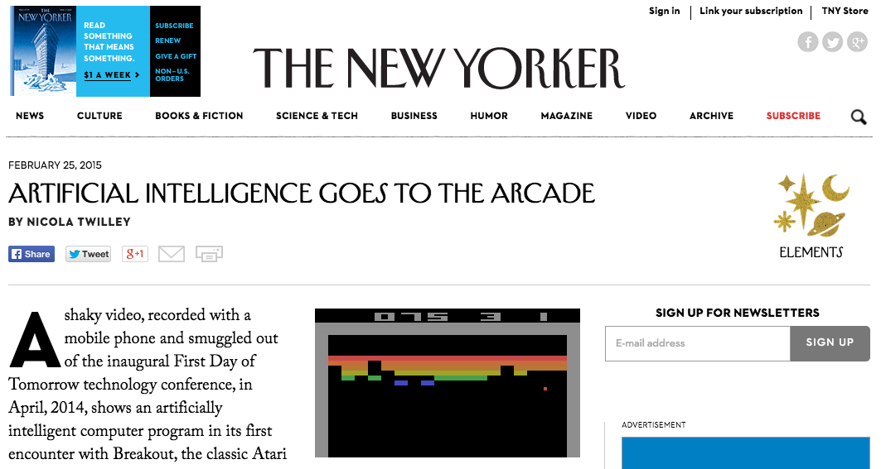
AI Games in the News
https://www.youtube.com/watch?v=EfGD2qveGdQ
https://www.youtube.com/watch?v=cjpEIotvwFY
Notes:
Video 1: 0:00 – 2:32

Slide 44
So What is AI?

Slide 45
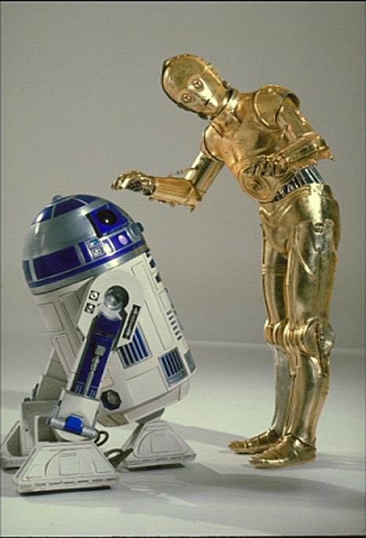
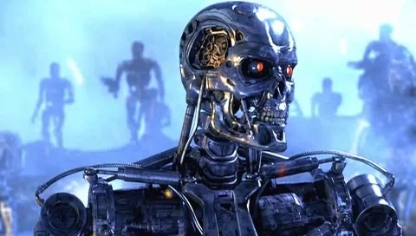
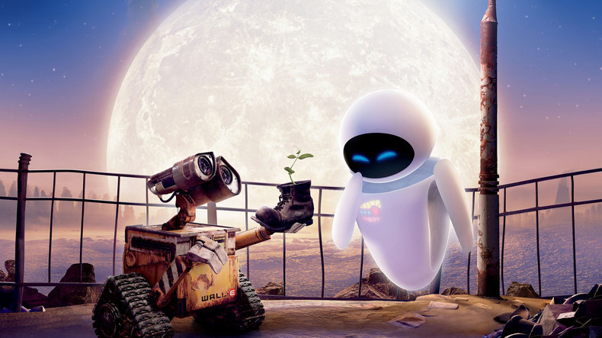
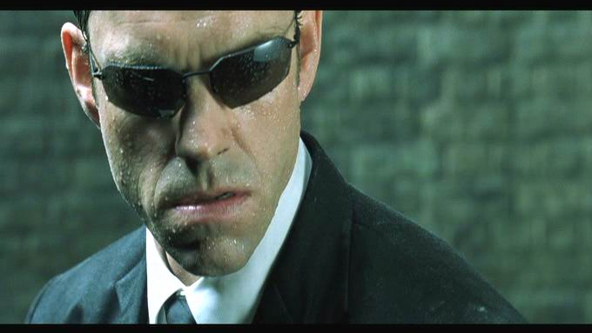
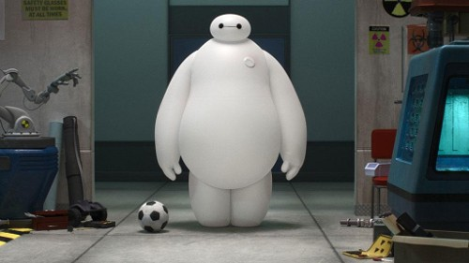
Sci-Fi AI?
Notes:
Who are these? C3PO, what does he do? Essentially google translate, (but with anxiety!)
Little guy? R2D2 – what does he do, yeah, not so sure
Things got darker: machines come back from the future – to kill us!
90’s : software is scary
Basic fear about what technology might do ?
What if we can’t even tell technology apart from ourselves?
OR maybe it’ll look really different and snarky

Slide 46
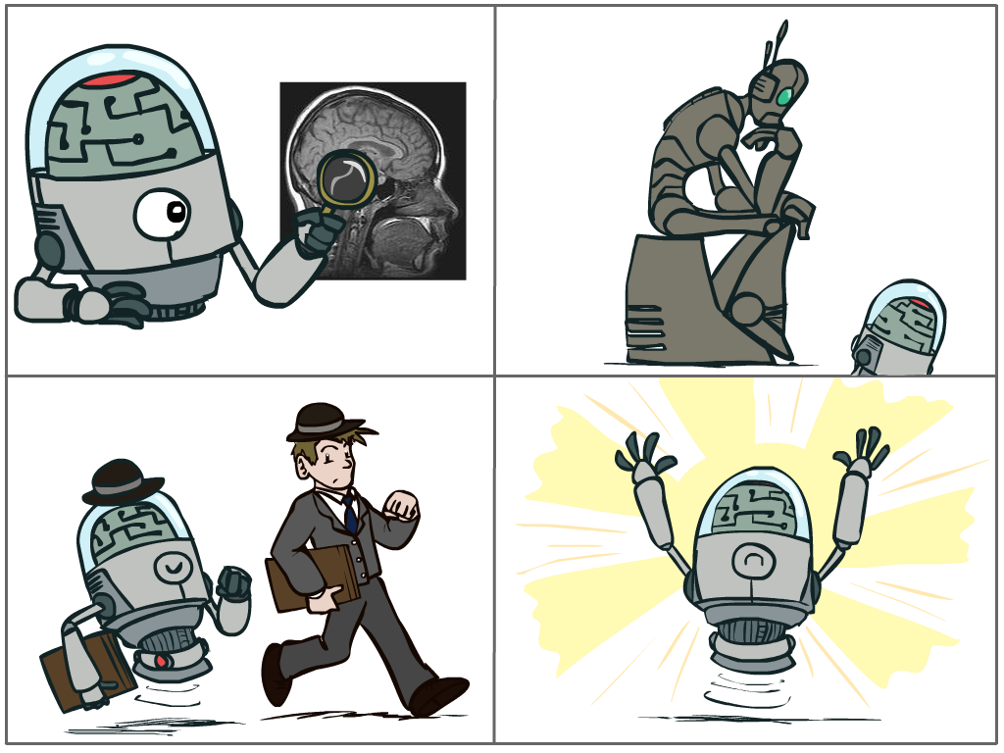
So What is AI?
The science of making machines that:
Think like people
Act like people
Notes:
Try to mimic humans!
Think like people is hard – cognitive science
More practical to make robots that act like people

Slide 47

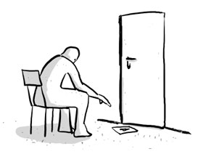
Turing Test for Intelligence
In 1950, Turing defined a test of whether a machine could “think”:
“A human judge engages in a natural language conversation with one human and one machine, each of which tries to appear human. If judge can’t tell, machine passes the Turing test.”
http://en.wikipedia.org/wiki/Turing_test
Notes:
Not always best to mimic humans – typos, slow at mental math, etc.

Slide 48
So What is AI?
The science of making machines that:
Think like people
Think rationally
Act like people
Act rationally
Notes:
What it decides and does is rational – it makes sense.

Slide 49
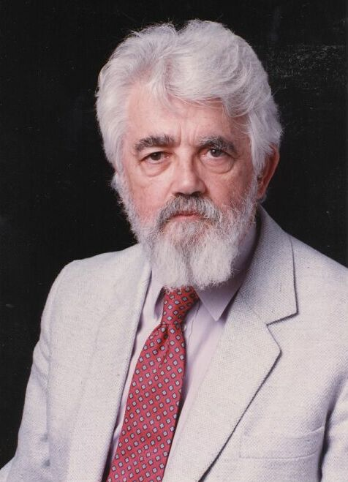
AI Definition by John McCarthy
“Getting a computer to do things which, when done by people, are said to involve intelligence”
Finesses the idea of whether a computer has consciousness, whether they have rights, etc.

Slide 50
Outline
What is AI?
AI History
AI winter and the resurgence
AI Today
Applications and how they work
AI Tomorrow
Ethics and the singularity

Slide 51
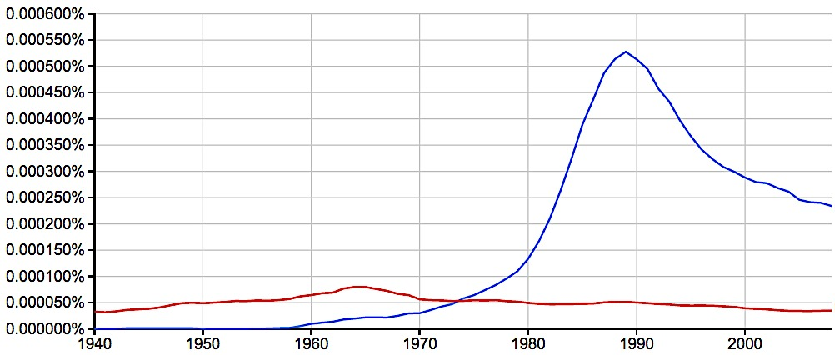
A Brief History of AI
AI
Excitement!
1950-1970
Knowledge Based
Systems
1970-1990
artificial intelligence
formal logic
Google Books Ngram Viewer: https://books.google.com/ngrams
Notes:
Percentage of times these exact pairs of words appeared compared to all pairs of words in the literature.
Formal logic – mathematical way of formulating reason and how people think
AI excitement followed the rise of early computers – if we can now get a computer to compute things, we can surely quickly get it to “intelligent machines.”
Knowledge Based Systems – taking all of the knowledge we have about the world and encoding that to create new rules based on inference.

Slide 52

Logic
A formal representation of our knowledge of the world
Use knowledge base and perception to infer new knowledge
http://www.rabittooth.com/gallery/spock_in_2012_by_rabittooth.jpg

Slide 53

isDog(animal)
$barks \& fur \& fourLegs⇔dog$
boolean isDog(animal A) {
if(!barks(A)) {
return false;
}
if(!hasFur(A)) {
return false;
}
if(!hasFourLegs(A)) {
return false;
}
return true;
}
What’s the problem?
Dog
Barks
Has Fur
Has four legs

Slide 54
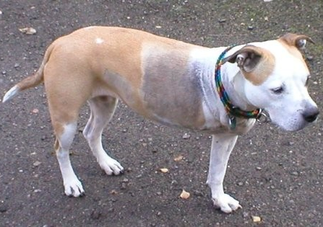
isDog(animal)
$barks \& fur \& fourLegs⇔dog$
What’s the problem?
Dog
Barks
Has Fur
Has four legs
Sheila
Notes:
How to fix?
Better sensors (DNA test)
Too specific – maybe only require a certain amount?
Use probabilities instead of boolean (statistical approach).

Slide 55
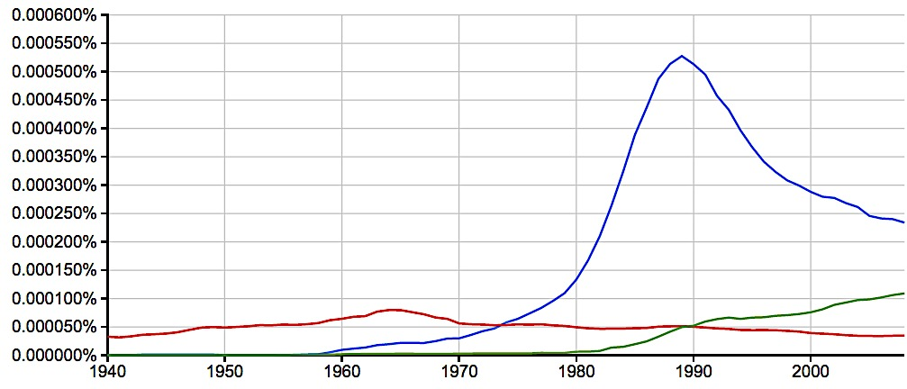
A Brief History of AI
AI
Excitement!
1950-1970
Knowledge Based
Systems
1970-1990
Statistical Approaches
1990-?
artificial intelligence
machine learning
formal logic
2008
Google Books Ngram Viewer: https://books.google.com/ngrams

Slide 56
Outline
What is AI?
AI History
AI winter and the resurgence
AI Today
Applications and how they work
AI Tomorrow
Ethics and the singularity

Slide 57
“Intelligent” Applications
Discuss in pairs/groups:
List at least four existing applications that seem intelligent
Audience responses:
Alexa, Siri – learn preferences, speech recognition
Google Maps – routing, path following, real-time updates
Google Translate – language detection, grammar, syntax
Pandora – learn musical preferences, suggestions

Slide 58
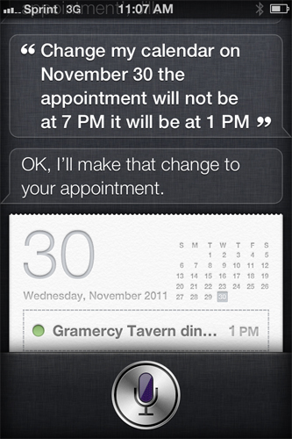
Applications: Natural Language
Speech technologies (e.g. Siri)
Automatic speech recognition (ASR)
Text-to-speech synthesis (TTS)
Dialog systems
Language processing technologies
Google translation
Web search
Spam filter

Slide 59
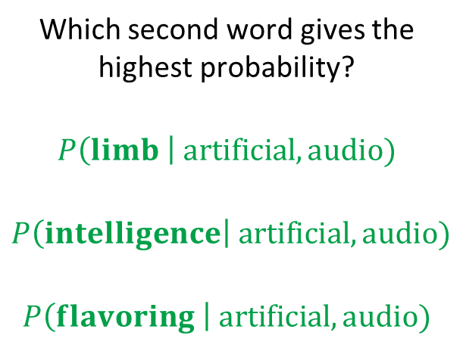
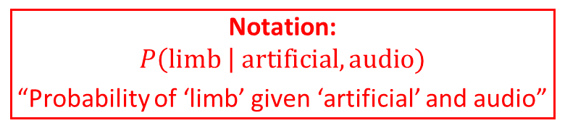
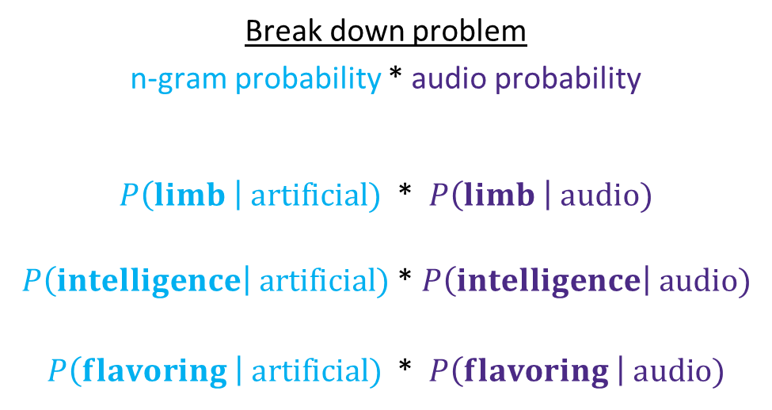
How: Probability
Notation:
$$P\left(limb \right| artificial, audio)$$
“Probability of ‘limb’ given ‘artificial’ and audio”
Example: speech recognition of “artificial …”
Find most probable next word given “artificial” and the audio for the second word
Which second word gives the highest probability?
$$P\left(limb \right| artificial, audio)$$
$$P\left(intelligence\right| artificial, audio)$$
$$P\left(flavoring \right| artificial, audio)$$
Break down problem
n-gram probability * audio probability
$P\left(limb \right| artificial)$ * $P\left(limb \right| audio)$
$P\left(intelligence\right| artificial)$ * $P\left(intelligence\right| audio)$
$P\left(flavoring \right| artificial)$ * $P\left(flavoring \right| audio)$

Slide 60
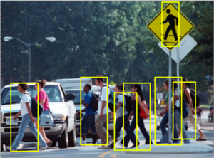
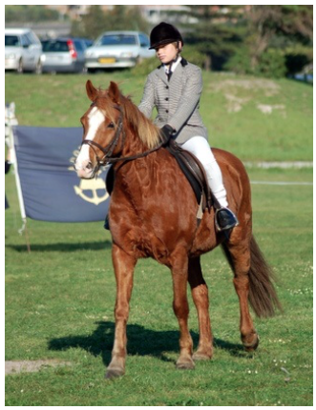

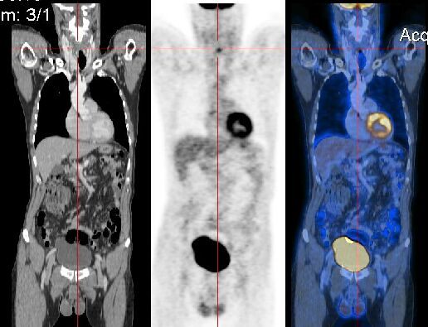
Applications: Vision (Perception)
Tasks related to understanding images/camera input
Pedestrian Detection
Segmentation
Alignment/Registration
Long, Shelhamer, Darrell. arXiv preprint arXiv:1411.4038 (2014).
https://en.wikipedia.org/wiki/Medical_image_computing#/media/File:CT-PET.jpg

Slide 61
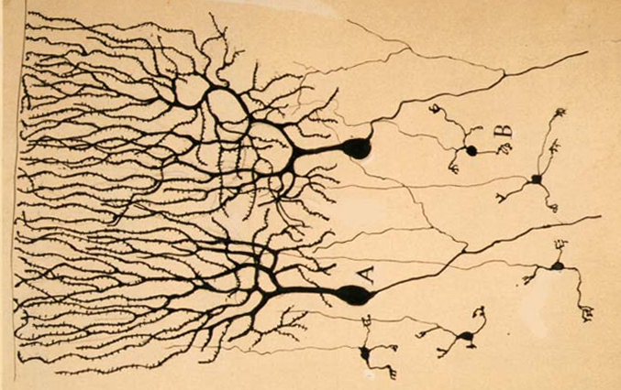
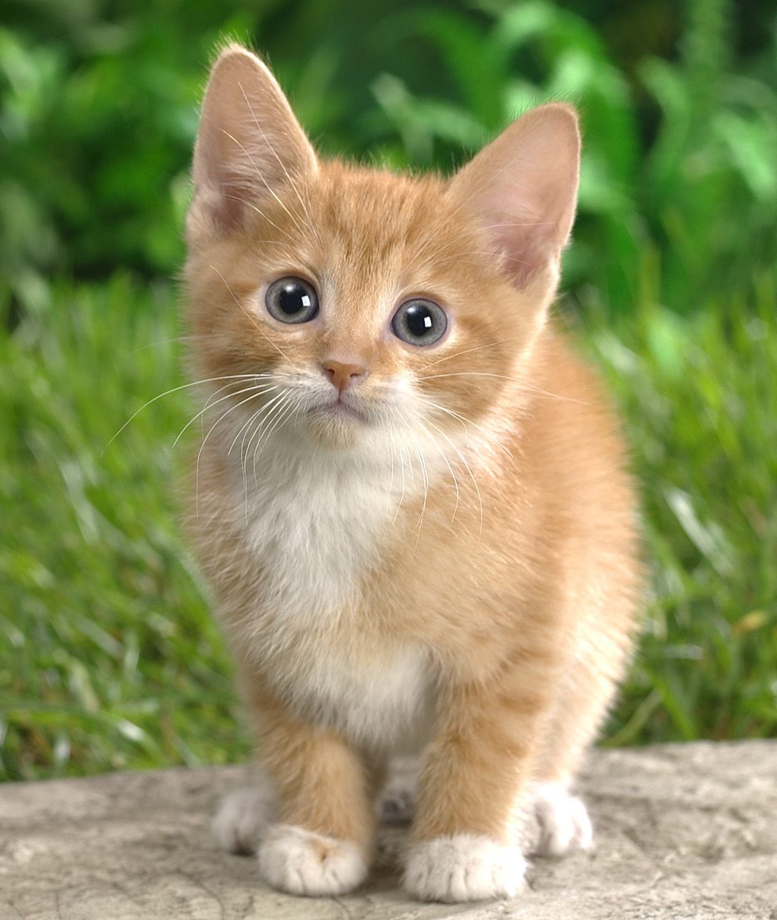
How: Neural Networks
Input Signal
Output
Signal
DOG
CAT
TREE
CAR
SKY
Image: https://en.wikipedia.org/wiki/Neuron
Notes:
Functions are connected to other functions using weights (sliders)

Slide 62
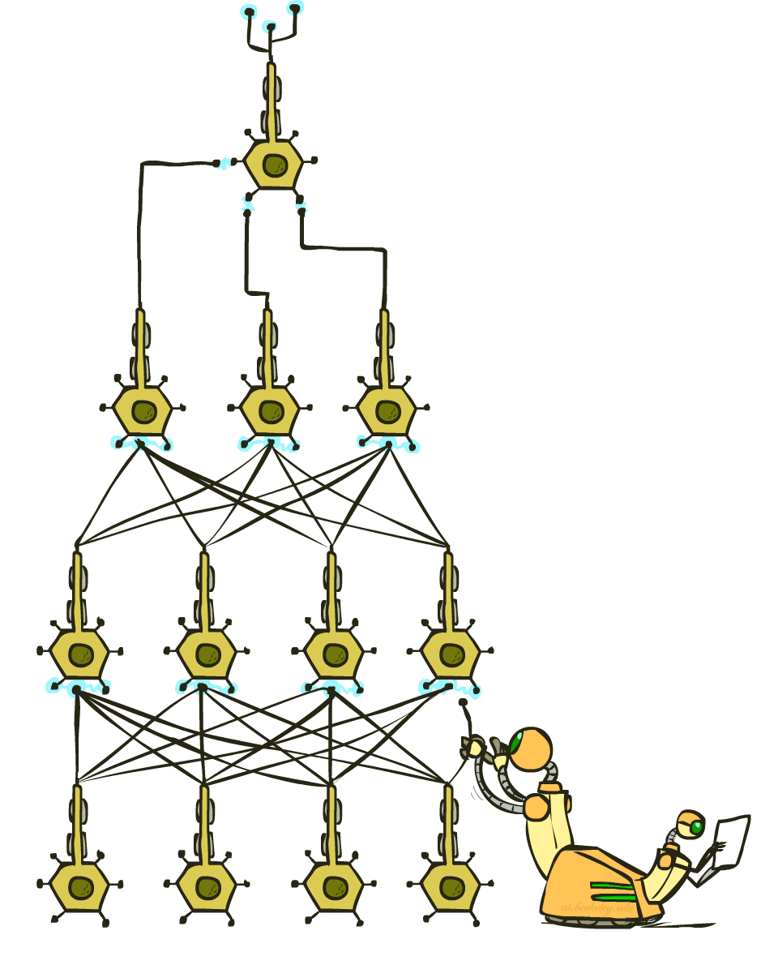
How: Neural Networks
Input Signal
Output
Signal
DOG
CAT
TREE
CAR
SKY
Image: https://en.wikipedia.org/wiki/Neuron

Slide 63
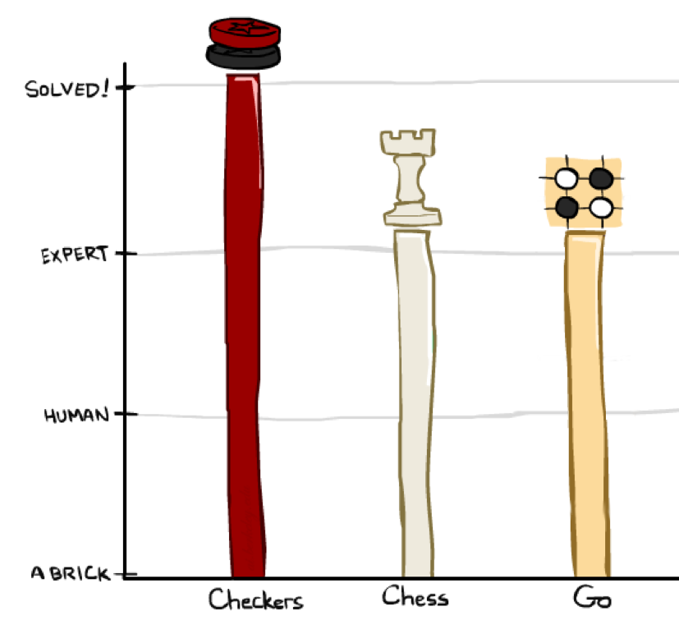
Applications: Games

Slide 64
How: Search & Planning
I take an action… then what? … then what?

Slide 65
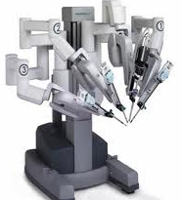
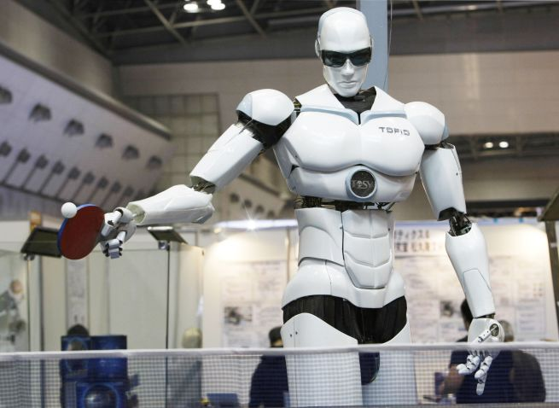
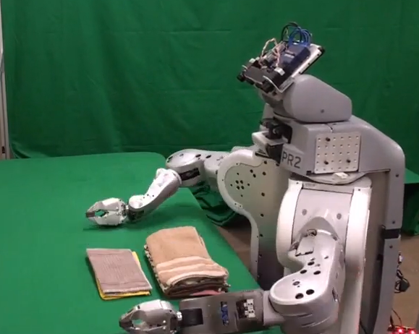
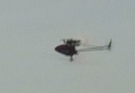
Applications: Robotics
For many, the coolest and scariest part of AI
Combines fields of AI/CS
Speech recognition
Synthetic voice
Machine vision
Planning
HCI
Surgical robots
Autonomous helicopter
TOPIO, the ping-pong playing robot
Towel-folding!

Slide 66
Applications: Robotics
Video: Bipedal Robot – Boston Dynamics
https://www.youtube.com/watch?v=rVlhMGQgDkY
Video: Robot Preschool – UC Berkeley
http://www.bloomberg.com/features/2015-preschool-for-robots/

Slide 67
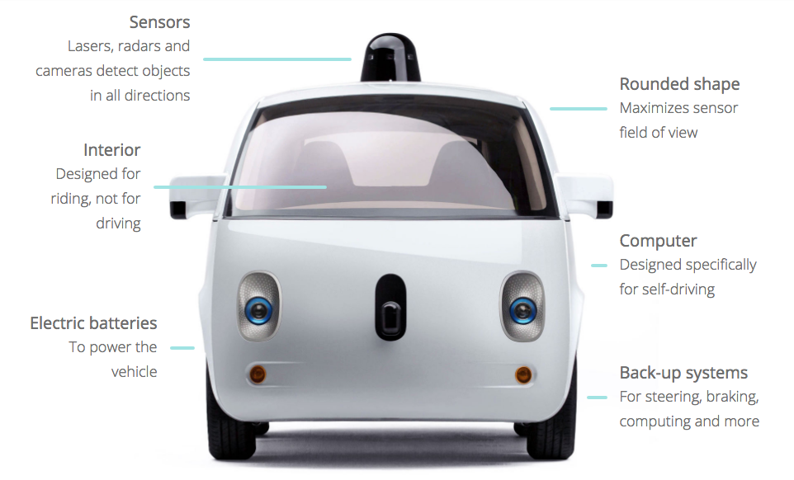
Applications: Driving
Image: https://www.google.com/selfdrivingcar/how/

Slide 68
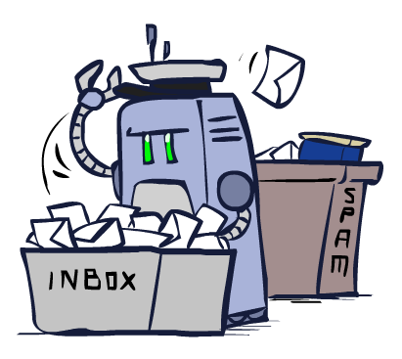
Applications: Much, Much More
Scheduling, e.g. airline routing, military
Route planning, e.g. Google maps
Medical diagnosis
Web search engines
Spam classifiers
Automated help desks
Fraud detection
Product recommendations
… Lots more!

Slide 69
Outline
What is AI?
AI History
AI winter and the resurgence
AI Today
Applications and how they work
AI Tomorrow
Ethics and the singularity

Slide 70
What’s In a Training Set?
Just like humans, machines can only learn what they are taught (or can read about on their own)
Biased training set = biased behavior
https://techcrunch.com/2016/12/10/5-unexpected-sources-of-bias-in-artificial-intelligence/
Examples:
In March 2016, Microsoft released AI Twitter bot Tay
http://www.complex.com/life/2016/03/microsoft-racist-ai
Software used to predict future criminals is biased against African Americans
https://www.propublica.org/article/machine-bias-risk-assessments-in-criminal-sentencing

Slide 71
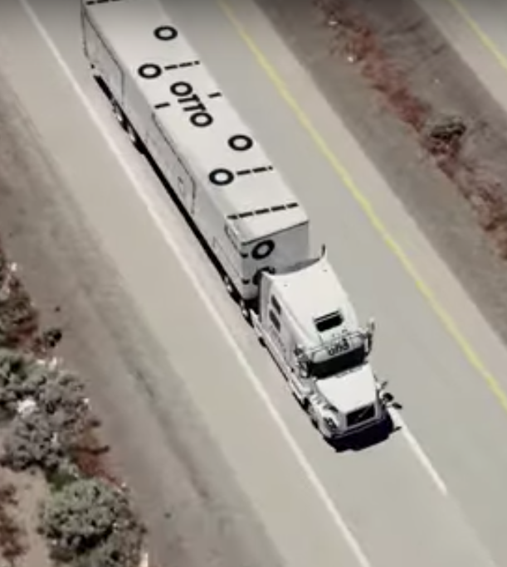
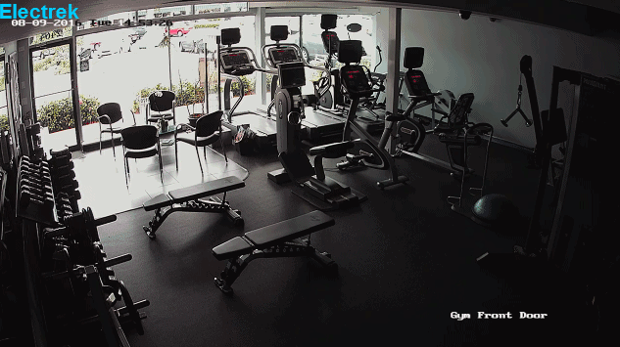
AI: What Should We Worry About?
AI Ethics: Immediate concerns
Jobs
Liability
Weapons
Images:
http://ot.to/
https://electrek.co/2016/09/25/tesla-model-s-crashes-into-gym-driver-claims-autonomous-acceleration-tesla-says-drivers-fault/
http://futureoflife.org/2016/09/20/podcast-what-is-nuclear-risk/

Slide 72
AI: Superintelligence
Singularity
Weak AI
Strong AI
Narrow AI
Limited number of applications
Artificial General Intelligence
Recursive self-improvement
Beyond human control

